Slide 1
Spawning Season 2014
Jake Heare

Slide 2
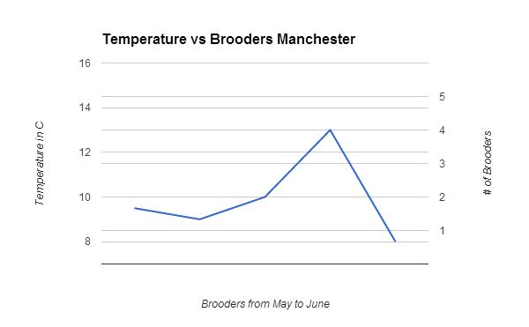
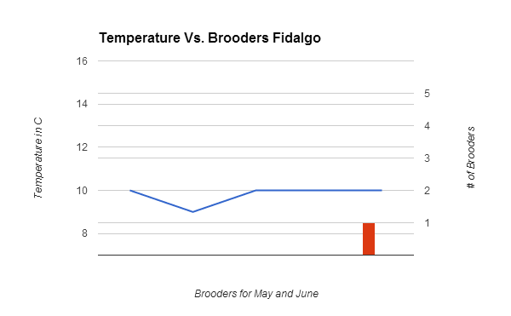
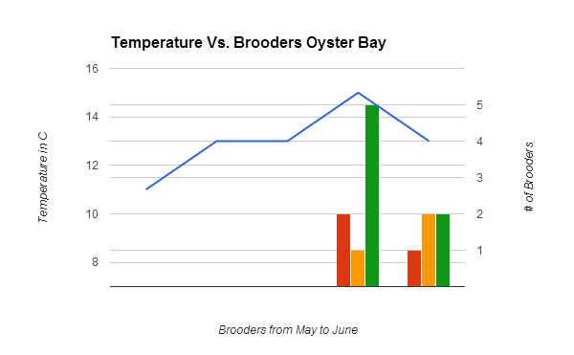
Temperature vs. # of Brooders
5/2/2014 | 5/16/2014 | 5/24/2014 | 5/30/2014 | 6/6/2014
4/30/20144 5/14/2014 5/21/2014 5/28/2014 6/4/2014
Northern Pop
Dabob Pop
Southern Pop
Temperature
5/1/2014 | 5/15/2014 | 5/22/2014 | 5/29/2014 | 6/5/2014

Slide 3
Northern Pop
Dabob Pop
Southern Pop
Temperature
4/30/2014 5/14/2014 5/21/2014 5/28/2014 6/4/2014

Slide 4
Northern Pop
Dabob Pop
Southern Pop
Temperature
5/1/2014 | 5/15/2014 | 5/22/2014 | 5/29/2014 | 6/5/2014

Slide 5
Northern Pop
Dabob Pop
Southern Pop
Temperature
5/2/2014 | 5/16/2014 | 5/24/2014 | 5/30/2014 | 6/6/2014

Slide 6
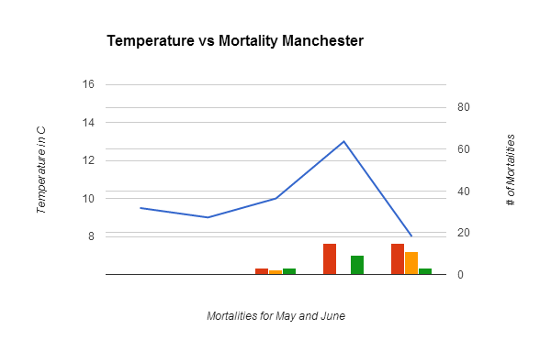
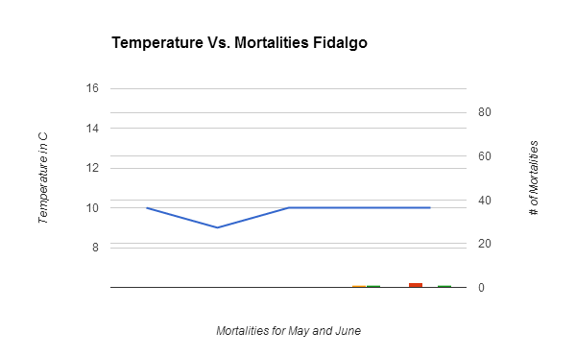
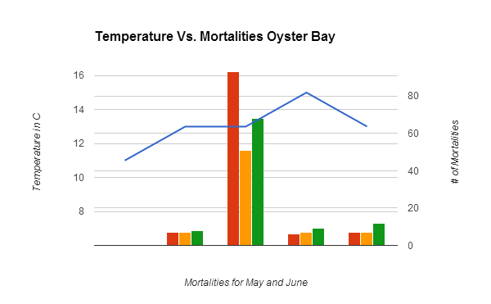
4/30/2014 5/14/2014 5/21/2014 5/28/2014 6/4/2014
5/2/2014 | 5/16/2014 | 5/24/2014 | 5/30/2014 | 6/6/2014
Northern Pop
Dabob Pop
Southern Pop
Temperature
5/1/2014 | 5/15/2014 | 5/22/2014 | 5/29/2014 | 6/5/2014
Mortalities Vs. Temperature

Slide 7
Northern Pop
Dabob Pop
Southern Pop
Temperature
4/30/2014 5/14/2014 5/21/2014 5/28/2014 6/4/2014

Slide 8
Northern Pop
Dabob Pop
Southern Pop
Temperature
5/1/2014 | 5/15/2014 | 5/22/2014 | 5/29/2014 | 6/5/2014

Slide 9
Northern Pop
Dabob Pop
Southern Pop
Temperature
5/2/2014 | 5/16/2014 | 5/24/2014 | 5/30/2014 | 6/6/2014

Slide 10
Date | 4/30/2014 | 5/14/2014 | 5/21/2014 | 5/28/2014 | 6/4/2014
Site | Manchester | Manchester | Manchester | Manchester | Manchester
Temp | 9.5 | 9 | 10 | 13 | 8
N | 1-4 | 9-12 | 13-16 | 5-8 | 1-4
Brooders | 0 | 0 | 0 | 0 | 0
Gaping |  | 31 | 40 | 54 | 43
Dead | 0 | 0 | 3 | 15 | 15
Closed |  | 28 | 48 | 28 | 32
Total | 90 | 59 | 91 | 97 | 90
% Brooding | 0.00% | 0.00% | 0.00% | 0.00% | 0.00%
H | 9-12 | 1-4 | 13-16 | 5-8 | 9-12
Brooders | 0 | 0 | 0 | 0 | 0
Gaping |  | 25 | 16 | 27 | 55
Dead | 0 | 0 | 2 | 0 | 11
Closed |  | 72 | 66 | 58 | 23
Total | 89 | 97 | 84 | 85 | 89
% Brooding | 0.00% | 0.00% | 0.00% | 0.00% | 0.00%
S | 13-16 | 9-12 | 5-8 | 1-4 | 13-16
Brooders | 0 | 0 | 0 | 0 | 0
Gaping |  | 43 | 76 | 43 | 60
Dead | 0 | 0 | 3 | 9 | 3
Closed |  | 55 | 12 | 40 | 31
Total | 94 | 98 | 91 | 92 | 94
% Brooding | 0.00% | 0.00% | 0.00% | 0.00% | 0.00%
Date | 5/1/2014 | 5/15/2014 | 5/22/2014 | 5/29/2014 | 6/5/2014
Site | Oyster Bay | Oyster Bay | Oyster Bay | Oyster Bay | Oyster Bay
Temp | 11 | 13 | 13 | 15 | 13
N | 13-16 | 5-8 | 13-16 | 5-8 | 5-8
Brooders | 0 | 0 | 0 | 2 | 1
Gaping |  | 46 | 3 | 51 | 52
Dead | 0 | 7 | 93 | 6 | 7
Closed |  | 14 | 5 | 10 | 8
Total | 100 | 67 | 101 | 67 | 67
% Brooding | 0.00% | 0.00% | 0.00% | 2.99% | 1.49%
H | 5-8 | 1-4 | 5-8 | 1-4 | 1-4
Brooders | 0 | 0 | 0 | 1 | 2
Gaping |  | 49 | 47 | 80 | 79
Dead | 0 | 7 | 51 | 7 | 7
Closed |  | 33 | 9 | 2 | 3
Total | 101 | 89 | 107 | 89 | 89
% Brooding | 0.00% | 0.00% | 0.00% | 1.12% | 2.25%
S | 5-8 | 13-16 | 5-8 | 13-16 | 13-16
Brooders | 0 | 0 | 0 | 5 | 2
Gaping |  | 59 | 2 | 74 | 60
Dead | 0 | 8 | 68 | 9 | 12
Closed |  | 26 | 4 | 10 | 21
Total | 74 | 93 | 74 | 93 | 93
% Brooding | 0.00% | 0.00% | 0.00% | 5.38% | 2.15%
Date | 5/2/2014 | 5/16/2014 | 5/24/2014 | 5/30/2014 | 6/6/2014
Site | Fidalgo | Fidalgo | Fidalgo | Fidalgo | Fidalgo
Temp | 10 | 9 | 10 | 10 | 10
N | 5-8 | 1-4 | 13-16 | 9-12 | 5-8
Brooders | 0 | 0 | 0 | 0 | 1
Gaping |  | 53 | 24 | 46 | 59
Dead | 0 | 0 | 0 | 0 | 2
Closed |  | 46 | 86 | 50 | 36
Total | 100 | 99 | 110 | 96 | 97
% Brooding | 0.00% | 0.00% | 0.00% | 0.00% | 1.03%
H | 13-16 | 5-8 | 9-12 | 1-4 | 13-16
Brooders | 0 | 0 | 0 | 0 | 0
Gaping |  | 48 | 53 | 50 | 58
Dead | 0 | 0 | 0 | 1 | 0
Closed |  | 52 | 30 | 40 | 33
Total | 94 | 100 | 83 | 91 | 91
% Brooding | 0.00% | 0.00% | 0.00% | 0.00% | 0.00%
S | 9-12 | 13-16 | 1-4 | 5-8 | 9-12
Brooders | 0 | 0 | 0 | 0 | 0
Gaping |  | 55 | 77 | 77 | 53
Dead | 0 | 0 | 0 | 1 | 1
Closed |  | 39 | 15 | 26 | 43
Total | 93 | 94 | 92 | 104 | 97
% Brooding | 0.00% | 0.00% | 0.00% | 0.00% | 0.00%

